Slide 1
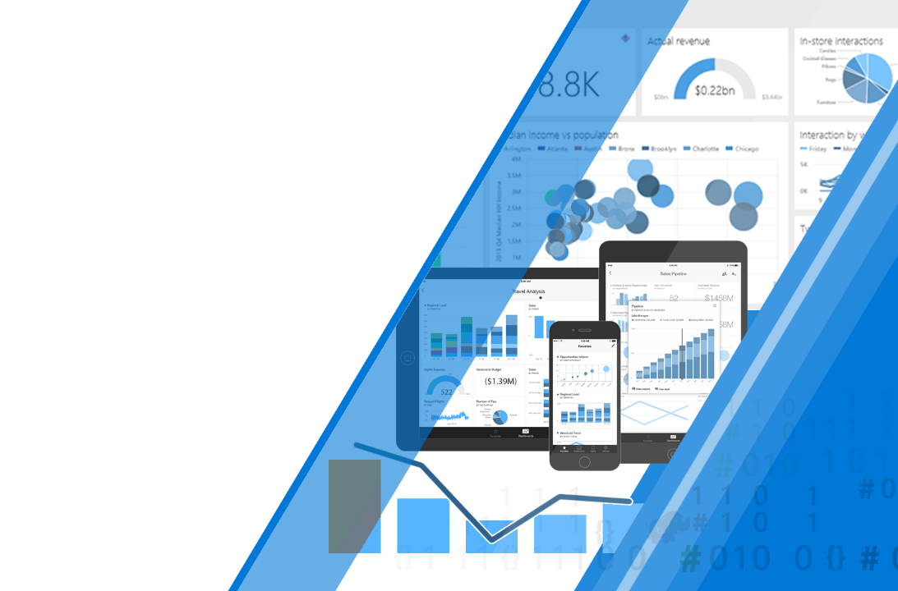
Microsoft Power BI
Direct Query Optimization and Best Practices

Slide 2
What we will cover
Understanding the Power BI Stack
Imported vs Direct Query vs Live Connection
Network Latency and Azure ExpressRoute
Understanding the PowerBI Query Engine
Formula and Storage Engine
Optimizing Power BI
Power BI Service Cache
Capturing Power BI Queries
Preferring the Storage Engine
DirectQuery Implications
Notes:
Columns closer to source db means less resources on PBI Service and on-the-fly processing
Use execution plans to improve on query performance by understanding weaknesses of model and improve indexing
Avoid complex queries in editor to avoid query folding
Relationships will have to wait for calculated columns and can force a table scan
Unique identifiers can also force table scan. We want to take advantage of columnar compression deduping
Assuming referential integrity will use Inner join instead of outer joins
Applying filters first minimizes the amount of data pulled from source systems
Cross highlighting is a nice feature but if it’s not necessary it’ll send extra un-needed queries
Reducing visuals is just good in general.
High cardinality is your enemy
Unnecessary precision can cause high cardinality. you could split highly unique datetime values into separate columns – e.g. month, year, date, etc. Or, where possible, use rounding on high-precision fields to decrease cardinality – (e.g. 13.29889 -> 13.3).
Common datawarehouse standard practices
DAX functions like RANKX – in the worst case, these functions can exponentially increase run-time and memory requirements given linear increases in table size.

Slide 3
Power BI Stack

Slide 4



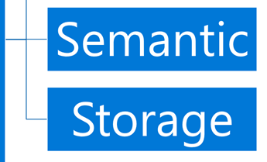
Power BI Imported
Front End Visualization Layer
Powered by HTML and Javascript
Power BI Web App
Semantic Layer
Handles Data Modeling
Managed by Power BI Service
Storage Layer
Dataset Storage
ETL and Refresh
Powered by M Language (Power Query)
Managed by Power BI Service
Notes:
Front End - Visualization Layer powered by HTML and Javascript
Semantic Layer – DAX Modeling (where we add meaning)
Storage Layer - Stored in Power BI Service and typically contains ETL

Slide 5
Power BI DirectQuery
Storage Layer Replaced
SQL Server manages the data
ETL has to be handled outside of Power BI
Also works with other enterprise databases
SQL Server
Notes:
With DirectQuery, the data storage is no longer handled by the Power BI service. The work is offloaded to a SQL Server.

Slide 6
Power BI Live Connection
Semantic and Storage Replaced
DAX (Tabular)
MDX (Multi-dimensional)
Processed in memory
Analysis Services
Notes:
For

Slide 7
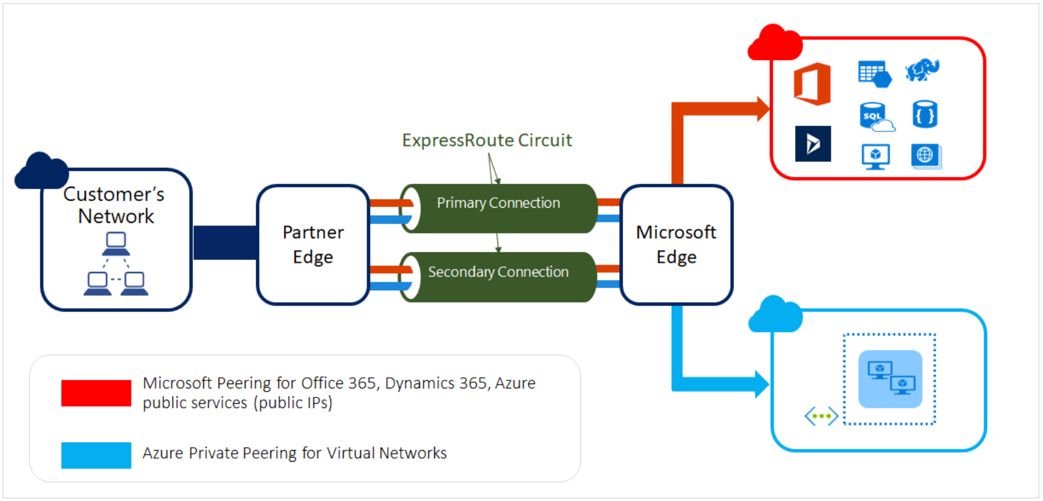
Network Latency and Azure ExpressRoute
Guidance
Ensure your Tenant’s home is located in the same region that you’re in. You can view your tenant’s “home” region by navigating to powerbi.com, selecting ? in the top right and then About Power BI.
You can also use the Azure Speed Test to check which region is closest to you.
Azure ExpressRoute
If you are finding that network latency is still an issue, consider using ExpressRoute.
Provides more reliability, faster speeds, lower latencies, and higher security than typical connections over the Internet.
Unlike VPN, it also has access to all services (validated list)
Notes:
Network latency has a much bigger impact when it comes to DirectQuery and Live Connections since you to wait for the data transfer from source to the Power BI Service
Tenant requests are routed to the region home region, then to the Power BI Service. The service then sends to azure bus and communicates to your gateway which may be in a different region!
ExpressRoute has edge partner that has Direct Connection to Data Center. You would connect directly through them and bypass most of the internet and thereby reducing the number of hops. Also nodes are verified so you can stay connected without having to re-route your connections.

Slide 8
PowerBI Query Engine

Slide 9
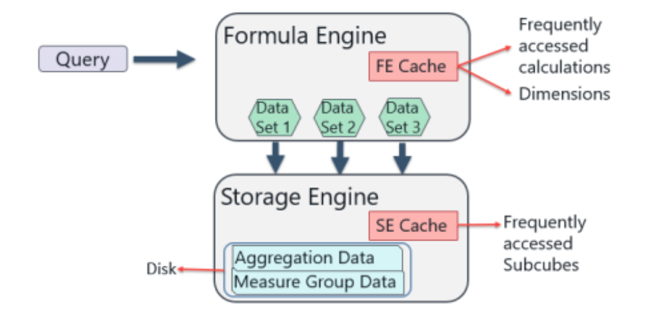
Formula And Storage Engine
Notes:
The Power BI Query Engine essentially the same as the SSAS Query Engine.
The storage engine is responsible for retrieving data from the database
The formula engine uses the information returned by the storage engine and performs more advanced calculations
Query is requested.
Formula Engine basic evaluation of query to determine what data it needs
FE Sends simplified requests down to storage engine
Storage Engine data from storage utilizing basic functions and generates multiple data caches.
Formula Engine iterates over the data caches and begins calculating complex DAX. Most time will be spent here

Slide 10
Formula And Storage Engine (cont.)
Formula Engine
Single Threaded
All DAX supported
Rich control over data
Uses the model’s relationships
Storage Engine
Multi-Threaded
Only simple expressions
Notes:
The Power BI Query Engine essentially the same as the SSAS Query Engine.
The storage engine is responsible for retrieving data from the database
The formula engine uses the information returned by the storage engine and performs more advanced calculations
Storage Engin

Slide 11
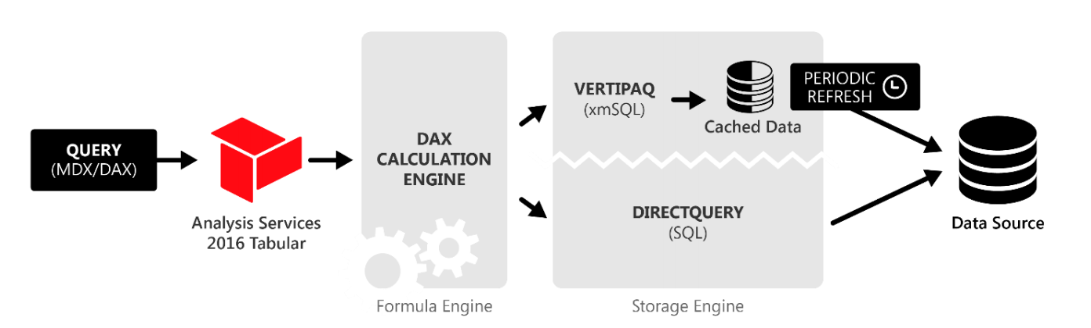
SSAS Query Engine
Notes:
This is the same for SSAS

Slide 12
DirectQuery Considerations
DB Design Guidance
Utilize Data warehousing standard architecture
Push Calculated Columns close to source database
Use Extended Events, Logs, and/or Traces to understand the execution plans for your queries
Look at index plans for commonly filtered/sliced columns
Modeling Guidance
Avoid complex queries in the editor
Avoid using calculated columns for relationships
Assume Referential Integrity when possible
Avoid Bi-Directional relationships if possible
General Optimization Guidance
Apply filters first before summarizing if possible
Switch off cross-highlighting when not necessary
Reduce the total number of visuals per page or use a dashboard with cards/gauges as landing page
Row level security is a nice feature but can cause a lot of performance issues. Use when necessary
Tables or columns that are unused should be removed if possible.
Avoid distinct counts on fields with high cardinality
Reduce unnecessary precision
Use integers instead of strings, where possible.
Be wary of DAX functions that need to test every row in a table
Notes:
Columns closer to source db means less resources on PBI Service and on-the-fly processing
Use execution plans to improve on query performance by understanding weaknesses of model and improve indexing
Avoid complex queries in editor to avoid query folding
Relationships will have to wait for calculated columns and can force a table scan
Unique identifiers can also force table scan. We want to take advantage of columnar compression deduping
Assuming referential integrity will use Inner join instead of outer joins
Applying filters first minimizes the amount of data pulled from source systems
Cross highlighting is a nice feature but if it’s not necessary it’ll send extra un-needed queries
Reducing visuals is just good in general.
High cardinality is your enemy
Unnecessary precision can cause high cardinality. you could split highly unique datetime values into separate columns – e.g. month, year, date, etc. Or, where possible, use rounding on high-precision fields to decrease cardinality – (e.g. 13.29889 -> 13.3).
Common datawarehouse standard practices
DAX functions like RANKX – in the worst case, these functions can exponentially increase run-time and memory requirements given linear increases in table size.

Slide 13
Optimizing Power BI

Slide 14
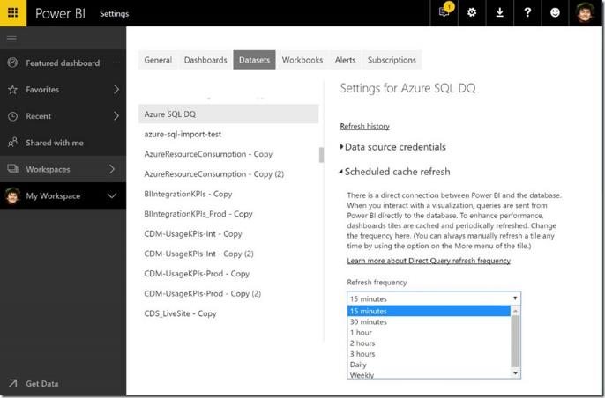
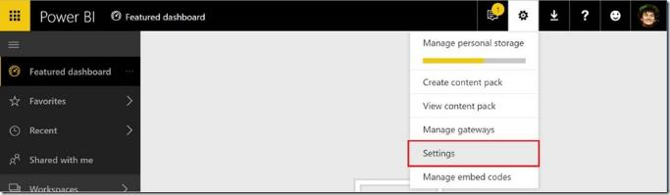
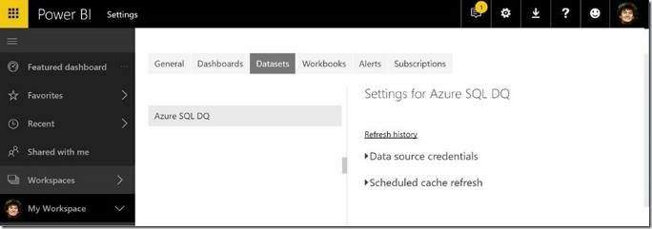
Power BI Service Caching
Power BI Service will cache queries when a dashboard is loaded
Visuals pinned to dashboards are served by the query cache when the dashboard is loaded.
When visiting the report directly, queries are made on the fly
Pinned live report tiles behave like reports
Retrieving data from query cache provides better performance than relying on data source
General Guidance
Utilize the dashboard as a landing page
For DirectQuery and live connection, this query cache is updated on a periodic basis by querying the data source.
Row Level Security generates a separate query cache per security context which can mean a lot more queries then necessary.
Notes:
Pin often used and highly requested visuals to the dashboards to use cache and reduce capacity consumption
DQ and Live Connection data updates happens every hour, though it can be configured in dataset settings.
https://powerbi.microsoft.com/en-us/blog/announcing-custom-cache-refresh-schedules-in-the-power-bi-service/
Each query cache update will send queries to the underlying data source to update the cache. The number of queries generated depends on the number of visuals pinned to dashboards relying on that data source.
For example, if you have two different roles that your users fall into, with two different views of the data, then during query cache refresh, two sets of queries are generated.

Slide 15
Capturing DAX Queries
Using SQL Server Profiler
Determine the port used by Power BI Desktop (netstat –b –n)
Note the port used by msmdsrv.exe
Connect SQL Server Profiler to Power BI Desktop
Start SQL Server Profiler from the Start menu
File > New Trace
Server Type: Analysis Services
Server name: localhost:[port number found above]
At the next screen, select Run
Now the SQL Profiler is live, and actively profiling the queries that Power BI Desktop is sending.
As queries are executed, you can see their respective durations and CPU times – using this information, you can determine which queries are the bottlenecks.
Using DAX Studio
Open Source product from SQLBI.com on GitHub
DEMO

Slide 16
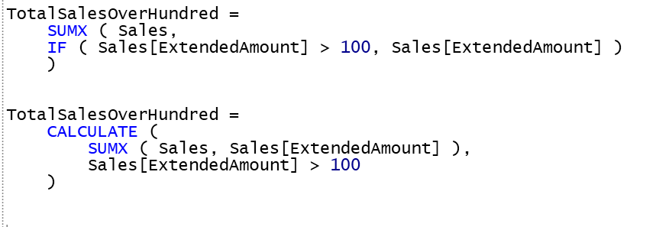
Preferring the Storage Engine
Use variables when computing fixed values
This is to avoid sending duplicate queries down to the storage engine
Consider changing your Data Model to enable the storage engine to execute instead of the Formula Engine
Calculated columns are injected into SQL Query
Be wary of table scans as they’ll require
Sometimes it’s better to not use Formula Engine only functions like “Divide”
Notes:
Recall that the formula engine is single threaded and the storage engine is multi threaded
Avoid sending duplicate queries down to storage engine
Recall that the storage engine is multi-threaded so it will always have better performance
We want to suggest the system to utilize the storage engine

Slide 17
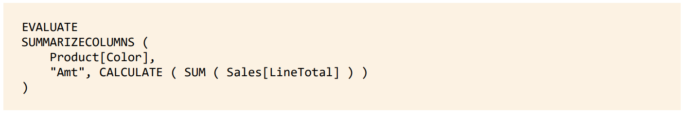
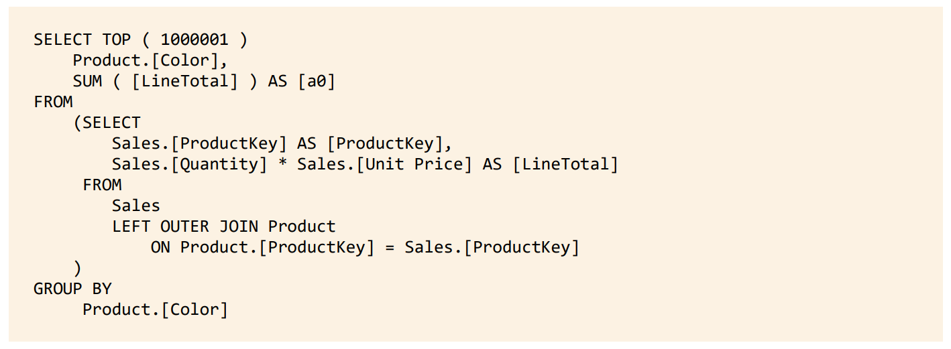
Calculated Columns in DirectQuery
Consider the following calculated column and query:
Since DirectQuery doesn’t manage the storage layer, there is no place to store data.
Calculated Columns are then generated on the fly when sent to the storage engine
To summarize the amount, it needs to first calculate LineTotal
Does a full table scan which is expected
Notes:
As you can see, every row is calculated every time you query this column in the model.
Consider materializing the calculated columns in the model.
Note that calculated columns in aggregations have the side effect of being computed again and again, but, depending on the size of the database, performance could be good enough.

Slide 18
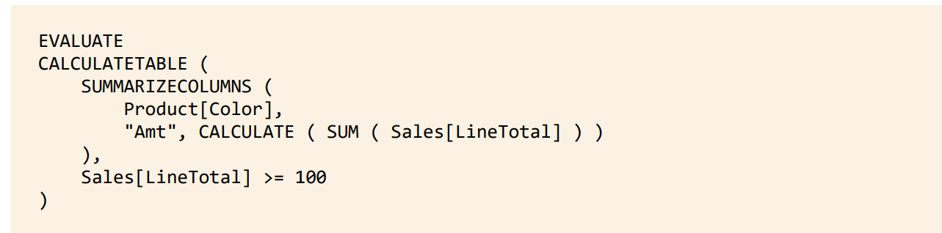
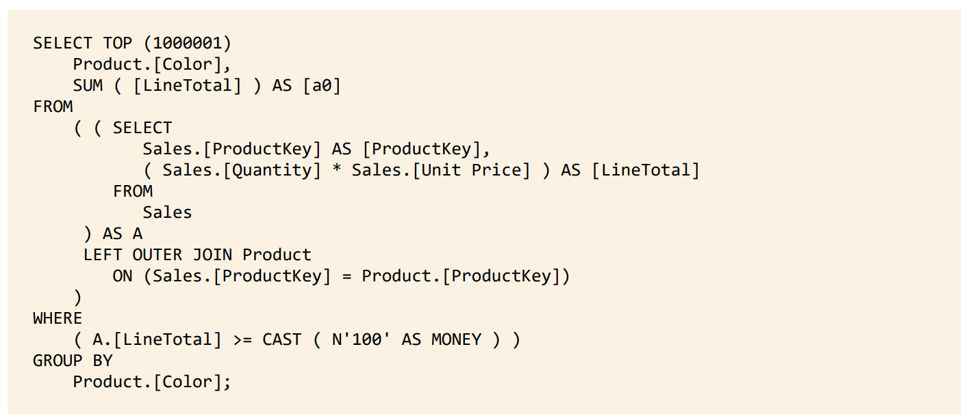
Calculated Columns in DirectQuery
Pitfall: Filtering on Calculated Columns
Note that the filtering still happens after a full scan on the table.
Notes:
Ideally, we think that filtering during our summarization might help reduce the query but in this case it didn’t help because Calculated Columns are not stored anywhere.
consider materializing the calculated column into the model
or use in-memory tabular model (it would be stored in the model)

Slide 19
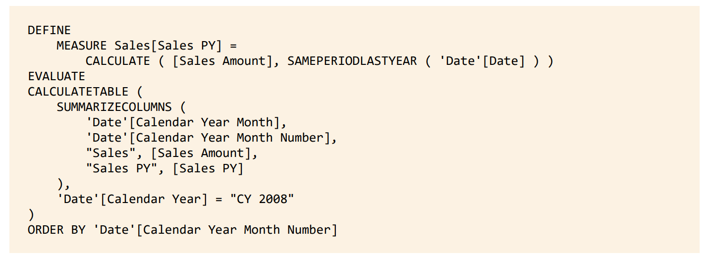
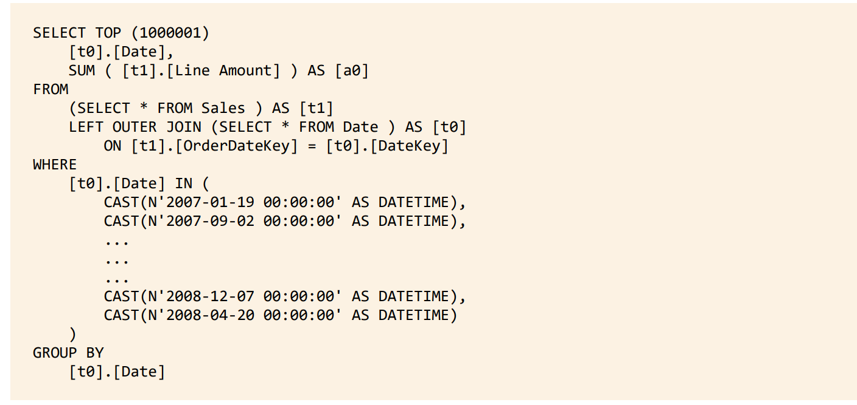
Additive & Non-Additive Measures
Consider the following measure utilizing Same Period Last Year:
The Storage Engine was smart enough to determine that it could calculate the value with SUM
It pulled the data at the biggest granularity the storage engine could handle then passed it to the formula engine for aggregation

Slide 20
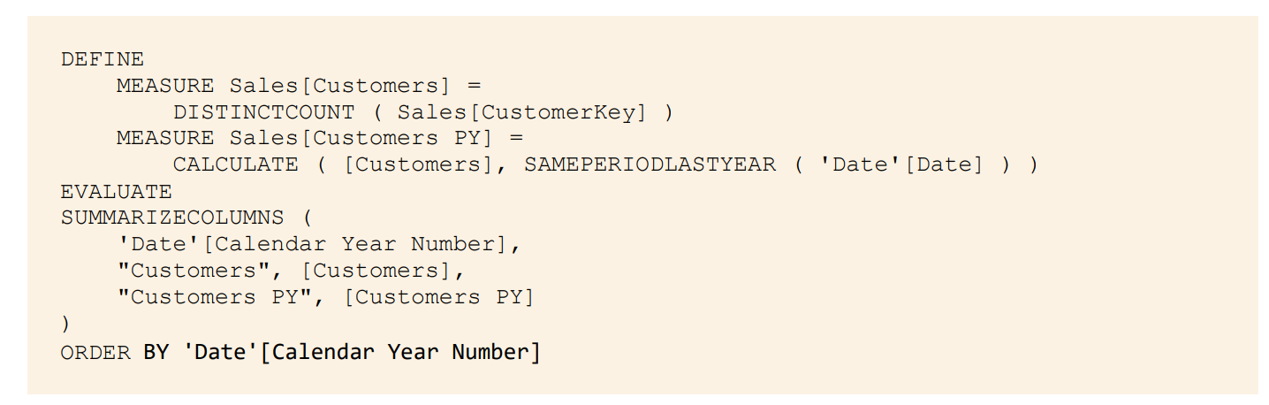
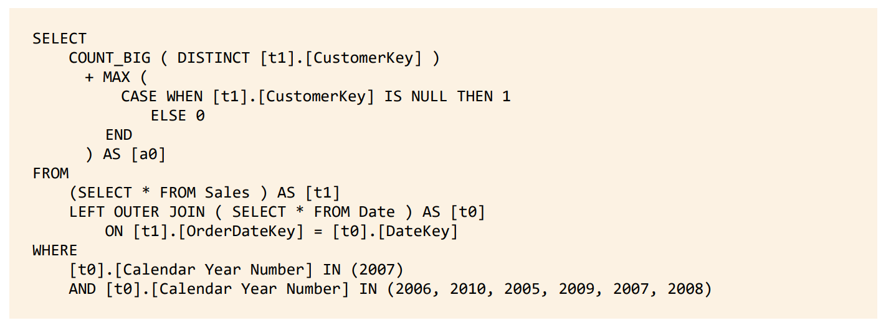
Additive & Non-Additive Measures
Consider the following where non-additive measure DistinctCount is used:
In this case, the DistinctCount forced Storage Engine to generate multiple queries (one for each year).
It needed to scan the fact table each time for separate distinct counts per year

Slide 21
Questions?

